Slide 1
Memory Requirement
Aras Edeş

Slide 2
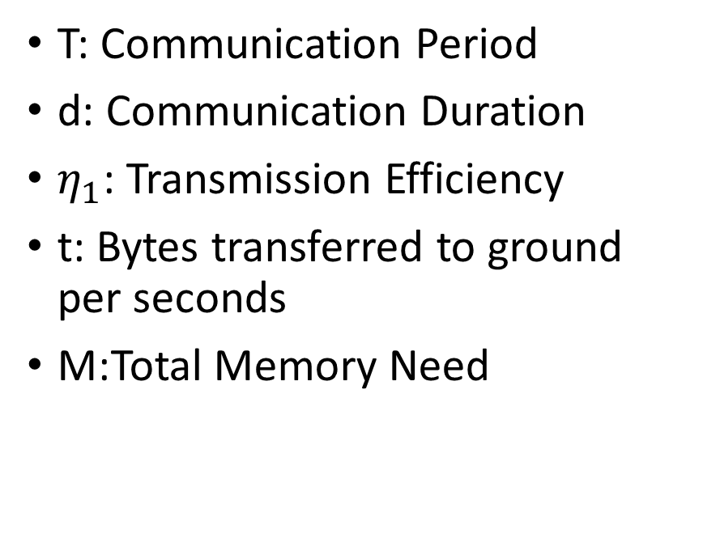
Data Generation
Data offloading
Image
Magnetometer, Dosimeter Readings
ADCS calculation results
Housekeeping Data
T: Communication Period
d: Communication Duration
$η_{1}$: Transmission Efficiency
t: Bytes transferred to ground per seconds
M:Total Memory Need

Slide 3





Example Data offloading Calculation
$$η_{1}=50\%$$
$$t=9600∗\frac{1}{8}∗η_{1}=600\frac{B}{s}$$
$$d=10∗60=600s$$
L: Communication Limit = $\frac{t∗d}{T}=600∗600=360\frac{kB}{T}$
$$T=2days$$
That’s not much

Slide 4


Image Memory Need
n: image size in pixels
m: size of pixel in bytes
f: Number of images per T
$M_{i}$: memory size in bytes
n = 2592 x 1944 pixels
m = 2B
f =
$M_{i}=N∗m∗f=9,6MB∗f$
We have to compress these images somehow

Slide 5
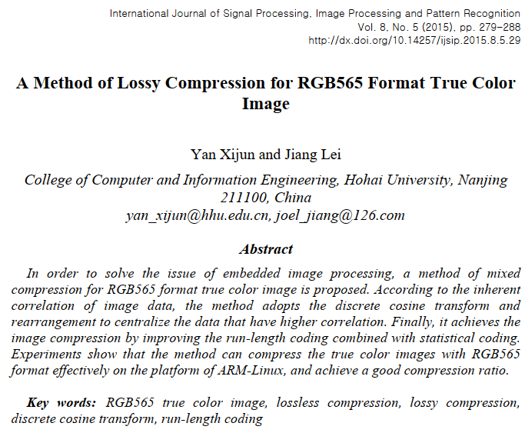
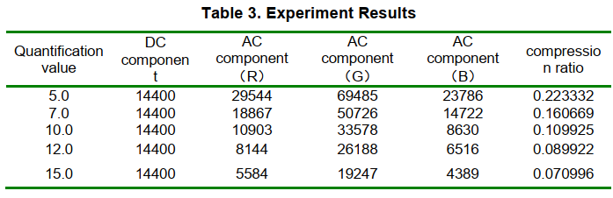
Image compression
http://ist.uwaterloo.ca/~anderson/images/GIFvsJPEG/compression_rates.html
About 1MB for an image then

Slide 6
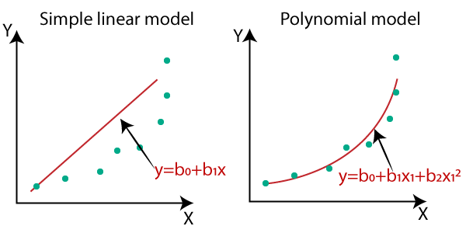

Edge detection is negligible in memory size
$m:$ Degree of polynomial
$M_{i2}$: Memory size in bytes
$M_{i2}=\left(m+1\right)∗4B$ $≤100B$
$L≫M_{i2}$

Slide 7
ADCS Memory Requirement

Slide 8
Housekeeping Memory Requirement

